Slide 1


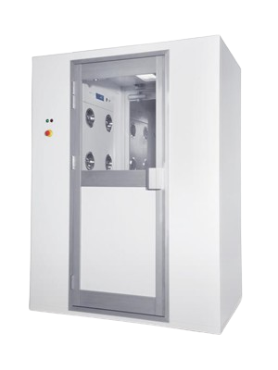
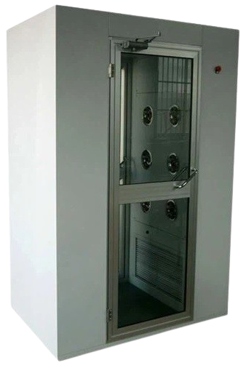
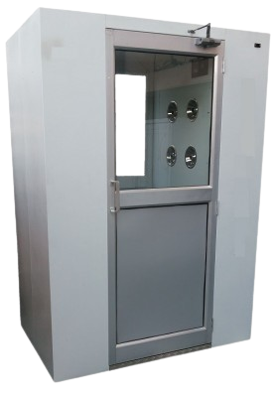
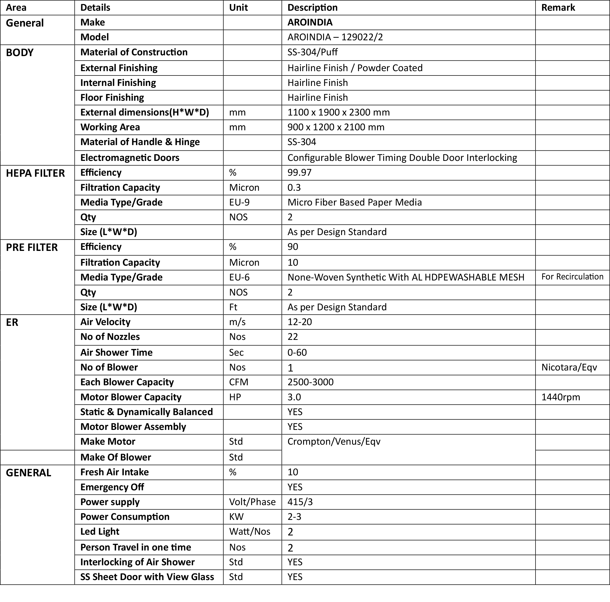
Cleanroom Air Shower | ARO-129022/2
Specification
A-117, 1st Floor, Near Dwarka More, Metro pillar no.-783, Sewak Park, New Delhi-110059, INDIA
Email:- aadi.int@gmail.com, Phone- 9599591802/803/804/805/806

